Slide 1
License Plate Blurring, Deblurring and Recognition
Haomin He & Boxuan Zhang

Slide 2
Haar Cascades
Object Detection using Haar feature-based cascade classifiers is an effective object detection method proposed by Paul Viola and Michael Jones in their paper, "Rapid Object Detection using a Boosted Cascade of Simple Features" in 2001.
For this project, our group use a Russian license plate detector .xml file.
By using the Haar Cascades, the license plate can be recognized as a small picture, that only displays the plate.
After the computation of Haar Cascades, the image can be operated by us.
Haar-like features.

Slide 3
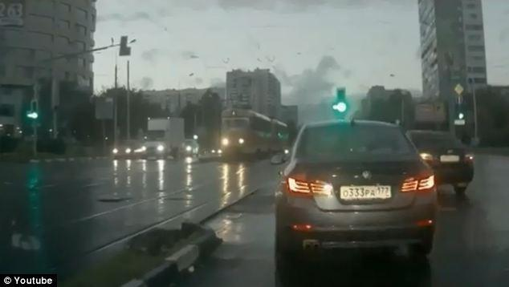
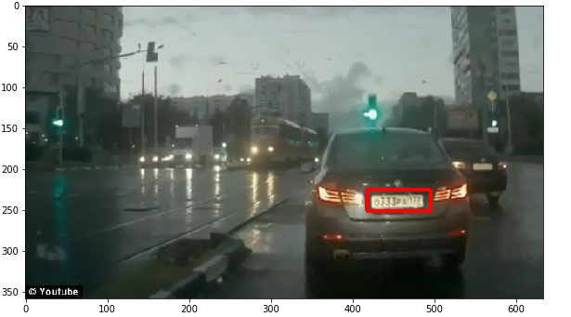
Demo
Use opencv rectangle function, find and capture the plate.

Slide 4
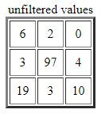
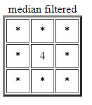

Blur & Median Value
Blurring is a method used in image processing operation.
The main idea is that delete the isolated noise point.
Median Blur:
Use nonlinear filtering
Effectively suppress noise
Basic Idea: replace the pixel with median value of all neighborhood pixels
Protect the edge details of images

Slide 5
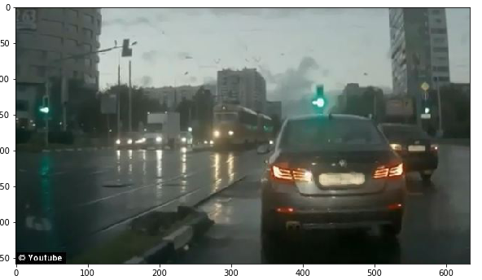
Demo
Call the blur function, and implement 5 x 5 filter.

Slide 6
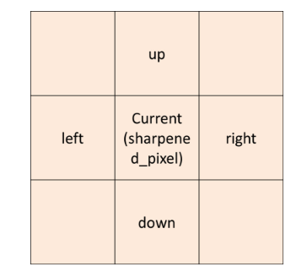
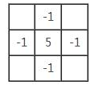
Picture Sharpening
Picture sharpening can increase image sharpness.
Increase edge and details, increase the contrast.
A Laplacian-based algorithm traverses the pixels in the image.
Determines the sharpened value by neighborhood pixels value.
The function used: sharpened_pixel = 5 * current – left – right – up – down ;
Sharpening Filter:

Slide 7
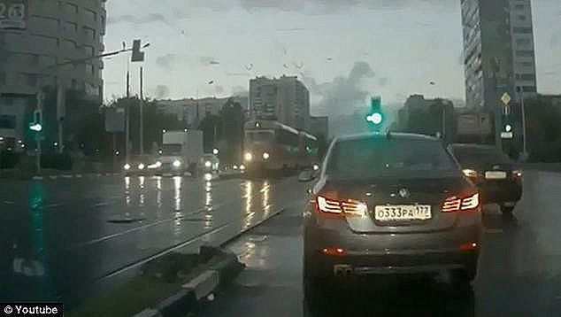
Demo
Call function deblur, and make the picture become more sharp.

Slide 8
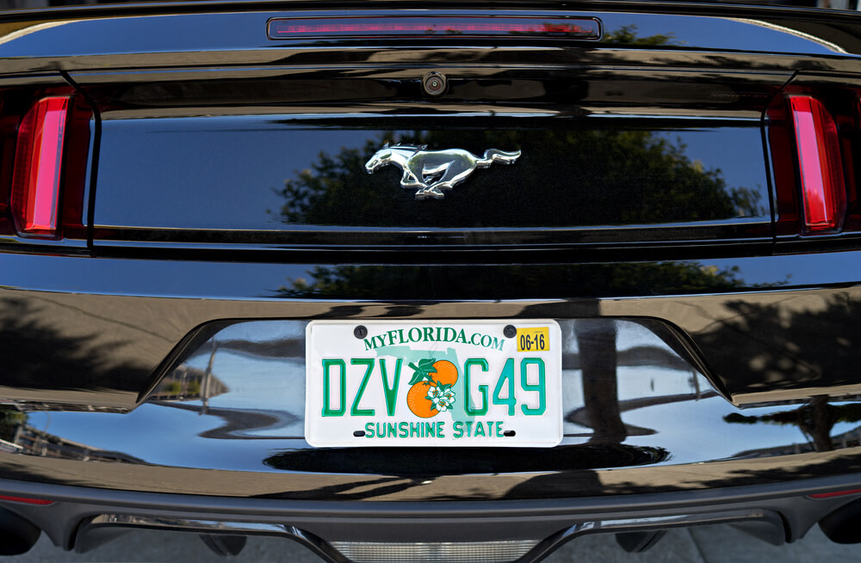
Plate Number Recognition Method
“Font and Background Color Independent Text Binarization” -> enhanced image -> Tesseract (an optical character recognition engine) -> convert plate image into a text file
Binarization: classify pixels into foreground and background
Canny edge detection on three color channels. E_{R}, E_{G}, E_{B}
Edge map E (E = E_{R} ∨ E_{G} ∨ E_{B})
The associated bounding box is computed
We call it edge-box (EB)
Consider: 15 pixels < EBs size< 1/5th of the image dimension. 0.1 < EBs aspect ratio < 10

Slide 9
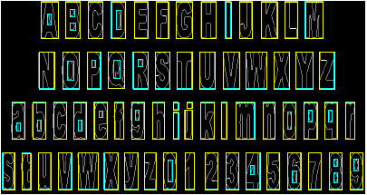
Edge Detection
Edge-boxes for the English alphabet and numerals. No character encloses more than two edge components
If a EB has 1 or 2 EBs that lie inside it -> EB is a text character
If a EB has 3 or more EBs lie inside it -> EB is a non-text character
Calculate foreground and background intensities on filtered EBs

Slide 10

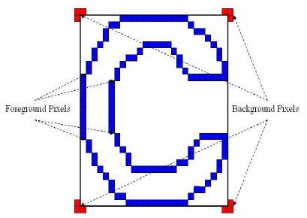
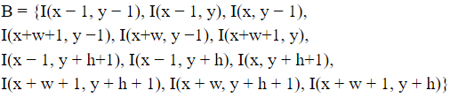
Foreground and Background Intensities
The foreground intensity (F_{EB}) is computed as the mean gray level intensity of the pixels that correspond to the edge pixels
The background intensity (B_{EB}) is based on intensity of three pixels each at the periphery of the corners of the bounding box

Slide 11
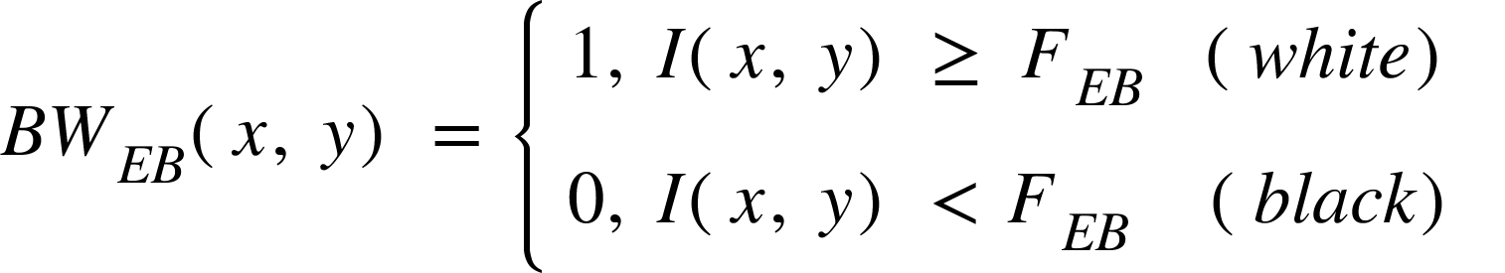
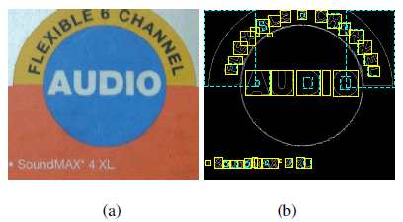
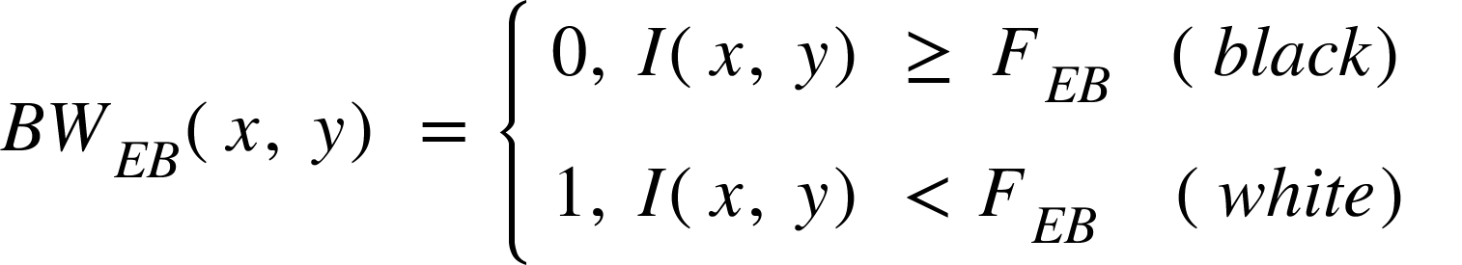
Foreground and Background Intensities
The background intensity (B_{EB}) = the median intensity of the 12 background pixels
Binarization using the foreground intensity (F_{EB}) as threshold
Foreground text: black; background: white
(F_{EB}) < (B_{EB}):
(F_{EB}) >= (B_{EB}):

Slide 12
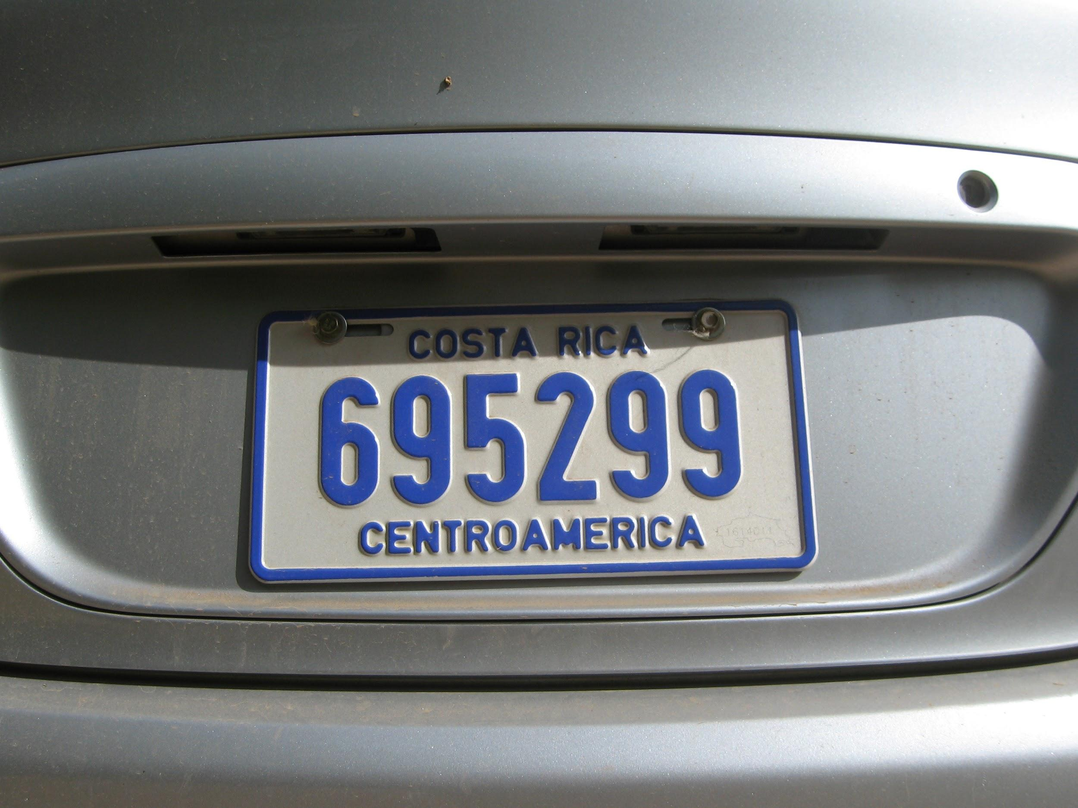
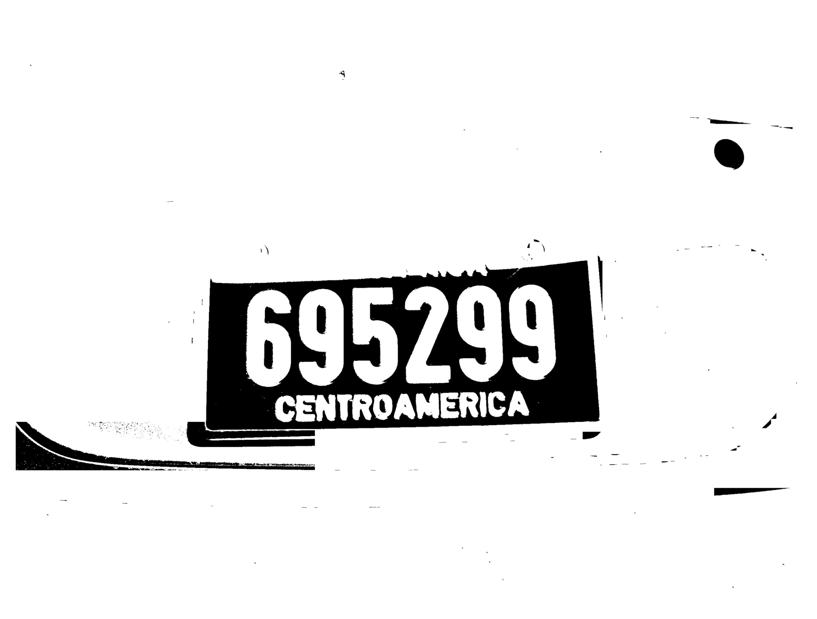
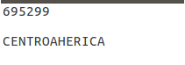
Tesseract
Optical character recognition engine
On the binarized output image -> convert the image into machine-encoded text
License plate number in a text file

Slide 13


